Slide 1


0
10
9
8
7
6
5
4
3
2
1

Slide 2

Robotics Corner

Slide 3
Sensors

Slide 4
01
Sensing for the robot
02
Commonly used sensors
AGENDA
03
Sensors in details
04
Sensors in Simulation

Slide 5


Common Sensors
IMU, Lidar, Incremental encoder
01285960031
01285960031
www.roboticscorner.tech

Slide 6
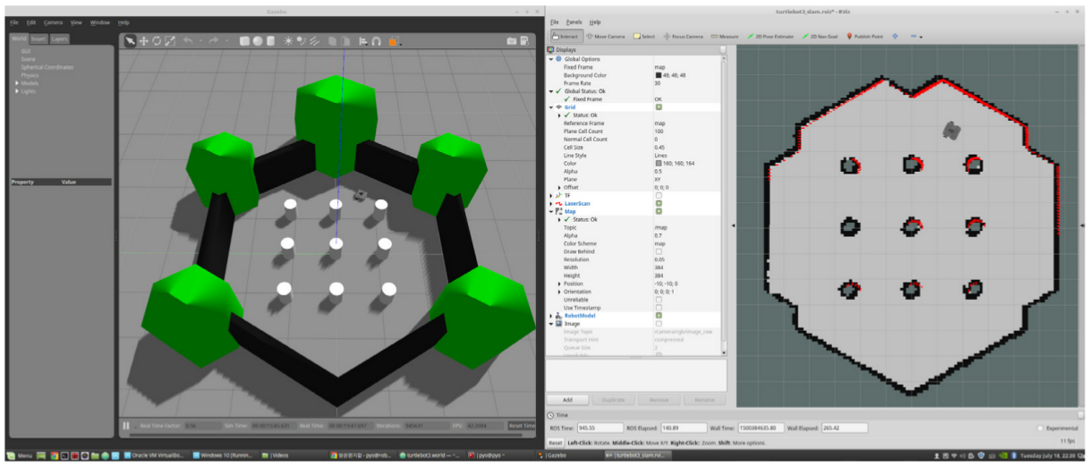
01
Sensing for the robot
Sense - Plan - Act
To accomplish a task, a robot should “understand” the environment from its sensor measurements.
Understanding: capturing the information at the right level of abstraction.
An autonomously navigating robot should know
what the environment looks like
where it is in the environment
…
01285960031
01285960031
www.roboticscorner.tech

Slide 7
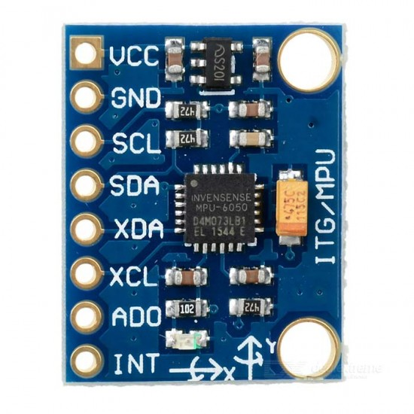
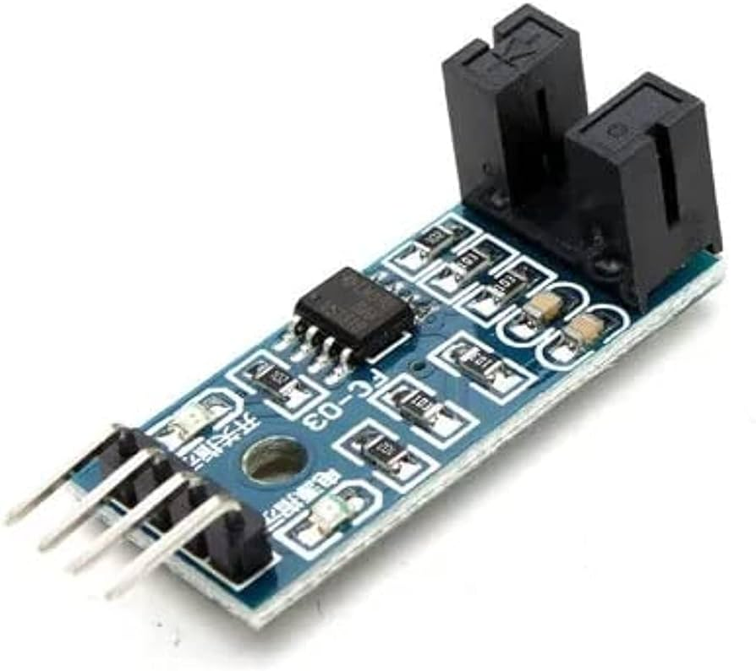
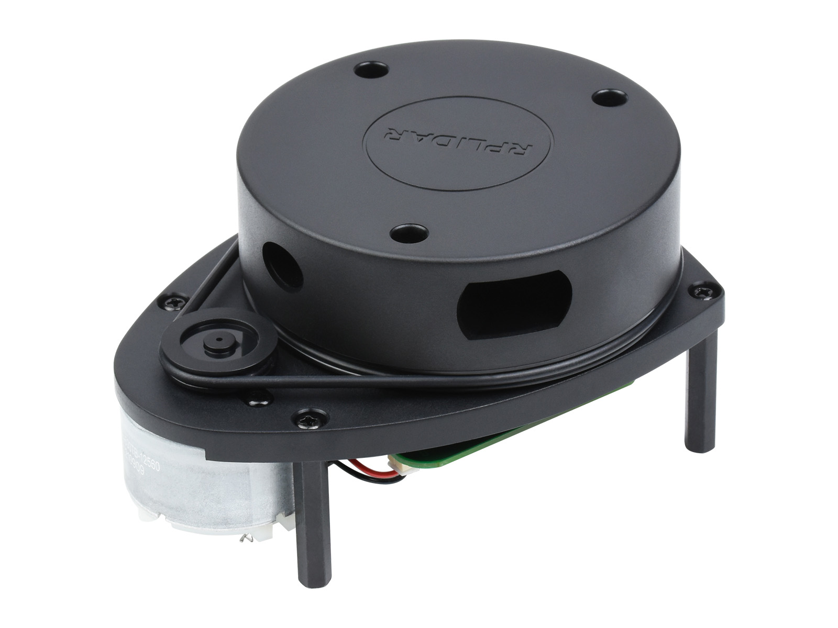
Commonly used sensors
02
Commonly used sensors
01285960031
01285960031
www.roboticscorner.tech

Slide 8
Lidar
03
Lidar
01285960031
01285960031
www.roboticscorner.tech

Slide 9
What is Laser Range Finder?
03
Lidar
Cameras can not measure the distance (depth).
Laser range finder is based on measuring the time of flight between the sent and received laser beam to estimate the distance..
01285960031
01285960031
www.roboticscorner.tech

Slide 10
The laser range finder could be used in:
03
Lidar
Obstacle avoidance.
Building maps (SLAM).
Robot navigation.
01285960031
01285960031
www.roboticscorner.tech

Slide 11
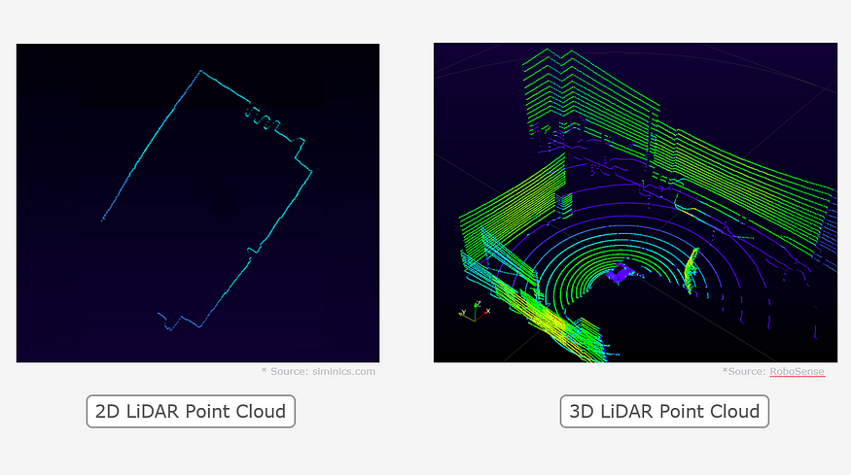
Lidar types
03
Lidar
There are two types of lidar: single-beam lidar and multi-beam lidar. Single beam lidar provides a 2D map of its surroundings whereas multi-beam lidar provides a 3D map of its surroundings.
01285960031
01285960031
www.roboticscorner.tech

Slide 12
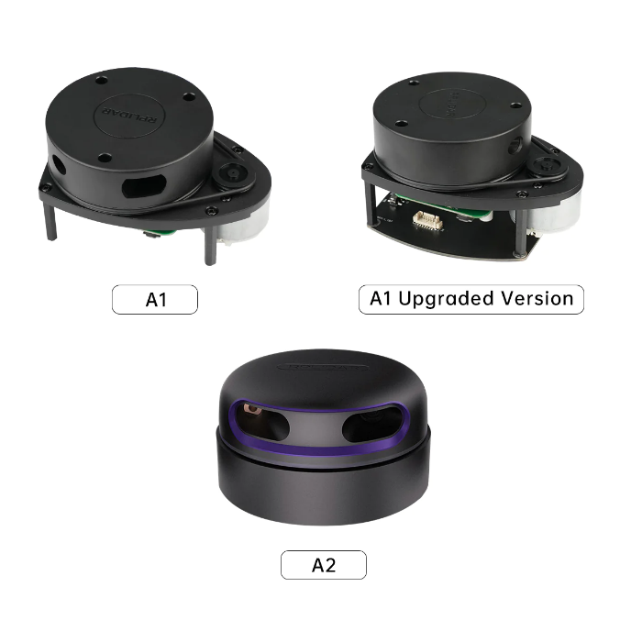
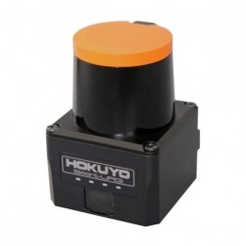
Lidar types
03
Lidar
01285960031
01285960031
www.roboticscorner.tech

Slide 13
Lidar Testing with linux / raspberry pi
03
Lidar
https://www.youtube.com/watch?v=XyGZpgFQKAo
mkdir -p ~/rp_ws/src
cd ~/rp_ws/src
git clone https://github.com/Slamtec/rplidar_ros
cd ../
catkin_make
source devel/setup.bash
catkin_make rplidarNode
ls -la /dev | grep ttyUSB
sudo chmod 666 /dev/ttyUSB0
roslaunch rplidar_ros view_rplidar_a1.launch
01285960031
01285960031
www.roboticscorner.tech

Slide 14
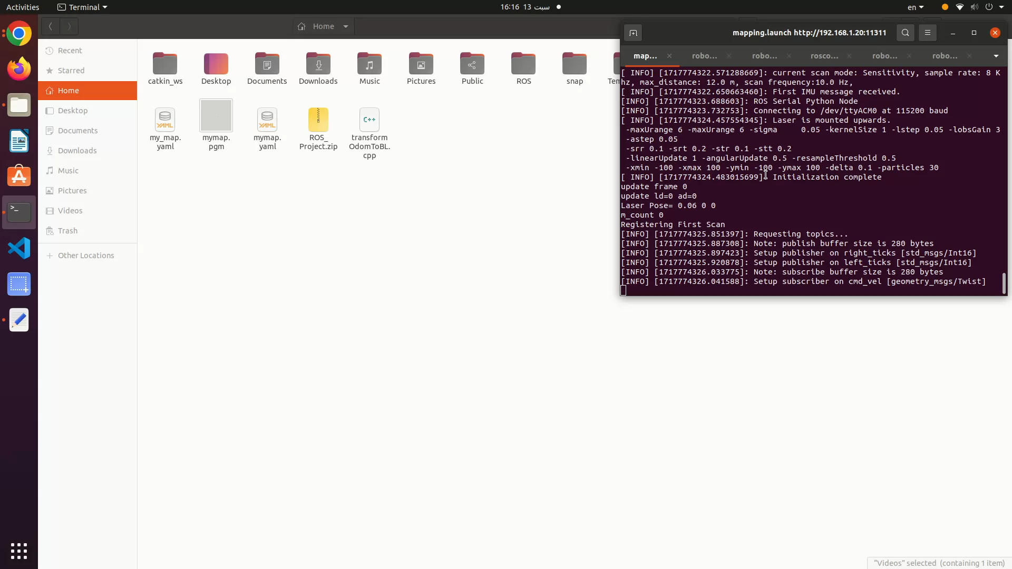
03
Lidar
01285960031
01285960031
www.roboticscorner.tech

Slide 15
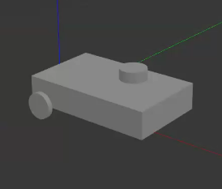
Lidar plugin in urdf
03
Lidar
To put the lidar plugin you should have a cylindrical link for the lidar and a joint connecting it to the body.
The gazebo lidar plugin is added at the end of the file and references the lidar link.
You can find the plugin in this link:
https://github.com/husarion/rosbot_description/blob/master/src/rosbot_description/urdf/rosbot.gazebo
01285960031
01285960031
www.roboticscorner.tech

Slide 16
03
Lidar
<gazebo reference="laser">
<sensor type="ray" name="head_rplidar_sensor">
<pose>0 0 0.06 0 0 0</pose>
<visualize>false</visualize>
<update_rate>40</update_rate>
<ray>
<scan>
<horizontal>
<samples>720</samples>
<resolution>1</resolution>
<min_angle>-3.14159265</min_angle>
<max_angle>3.14159265</max_angle>
</horizontal>
</scan>
<range>
<min>0.2</min>
<max>12.0</max>
<resolution>0.01</resolution>
</range>
<noise>
<type>gaussian</type>
<mean>0.0</mean>
<stddev>0.01</stddev>
</noise>
</ray>
<plugin name="gazebo_ros_head_rplidar_controller" filename="libgazebo_ros_laser.so">
<topicName>scan</topicName>
<frameName>laser</frameName>
</plugin>
</sensor>
</gazebo>
01285960031
01285960031
www.roboticscorner.tech

Slide 17
IMU
03
IMU
01285960031
01285960031
www.roboticscorner.tech

Slide 18
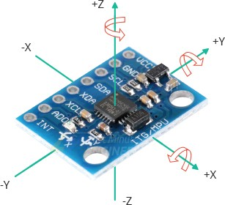
What is IMU?
03
IMU
IMU (sometimes referred to as an inertial reference unit [IRU] or motion reference unit [MRU]) is typically an electromechanical or solid-state device that contains an array of sensors that can measure motion. That is, to detect linear acceleration (the rate of change in velocity) and angular rate (change in angular velocity) in about the X, Y and Z axes and provide data about that motion
01285960031
01285960031
www.roboticscorner.tech

Slide 19
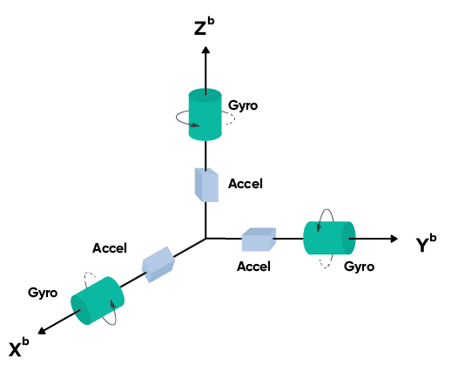
What is IMU?
03
IMU
The IMU can measure motion by converting the detected inertia, which are forces created due to an object’s resistance to changing direction, into output data that describes the motion of the object. This data will be used by some other system, for example, to control a vehicle. The output of an IMU is typically the raw sensor data from:
accelerometers (linear acceleration measurements along each axis)
gyroscopes (rotational rates/angular velocity measurements around each axis)
01285960031
01285960031
www.roboticscorner.tech

Slide 20
IMU plugin in gazebo
03
IMU
Like the lidar, the imu plugin is put at the end of the URDF file
There is a plugin for IMU that needs to have a link as a reference
There is another plugin for IMU that doesn’t need to have a link as a reference
You can find the IMU plugin here:
https://classic.gazebosim.org/tutorials?tut=ros_gzplugins
01285960031
01285960031
www.roboticscorner.tech

Slide 21
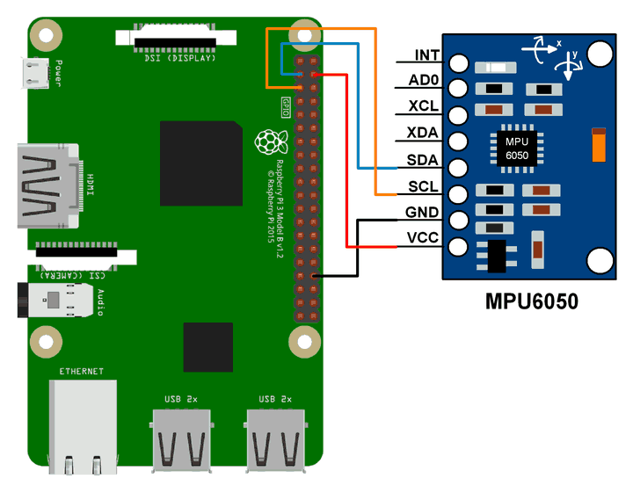
03
IMU
Note: Vcc can be connected with the 3.3 volts instead
MPU6050 with Raspberry PI connection
01285960031
01285960031
www.roboticscorner.tech

Slide 22
MPU6050_driver
03
IMU
Building:
The first step to build this package is install its dependency. To that, clone the i2c_device_ros package into your workspace
$ cd <YOUR_WS>/src $ git clone https://github.com/Brazilian-Institute-of-Robotics/i2c_device_ros.git
Now, clone the latest version from this repository into your catkin workspace
$ cd <YOUR_WS>/src $ git clone https://github.com/Brazilian-Institute-of-Robotics/mpu6050_driver.git $ cd ../
Then, to build the package you could use two options:
pure catkin:
$ catkin_make -DCATKIN_WHITELIST_PACKAGES="mpu6050_driver;i2c_device_ros;
catkin tool:
$ catkin build mpu6050_driver
Or just $catkin_make
01285960031
01285960031
www.roboticscorner.tech

Slide 23
Calibration Process
03
IMU
The first thing to do is run the calibration process. To run the calibration process, put the sensor on its final place on your robot (this is strongly important!) and then run the calibration node:
$ roslaunch mpu6050_driver mpu6050_calibration.launch
The process will take a few minutes to finish. While that, you can see the IMU data in the topic called "imu" and the offsets applied to MPU6050 calibration registers in the topic "imu_offsets". In a new terminal, you can see the imu messages runnig
$ rostopic echo /imu -c
and the offsets running on a new terminal
$ rostopic echo /imu_offsets –c
You'll see the angular velocity and linear acceleration values converging to zero, except for the accelerometer Z axis which the value will converge to gravity aceleration value (9,8 m/s²).
When the calibration process finish, you'll see the final offsets. For not run the calibration process all the time that you turn on your robot, pick these values and put in the offsets field in mpu_settings config file.
01285960031
01285960031
www.roboticscorner.tech

Slide 24
Running main node
03
IMU
After to calibrate the MPU sensor, you can run the main node with
$ roslaunch mpu6050_driver mpu6050_driver.launch
Config files
mpu_settings.yaml: All parameters of MPU6050 used in the calibration node and main node
Launch files
mpu6050_calibration.launch: Launch the calibration node
mpu6050_driver.launch: Launch the main node
Published Topics: /imu (sensor_msgs/IMU) Imu data with the values from MPU6050 accelerometer and gyroscope
01285960031
01285960031
www.roboticscorner.tech

Slide 25
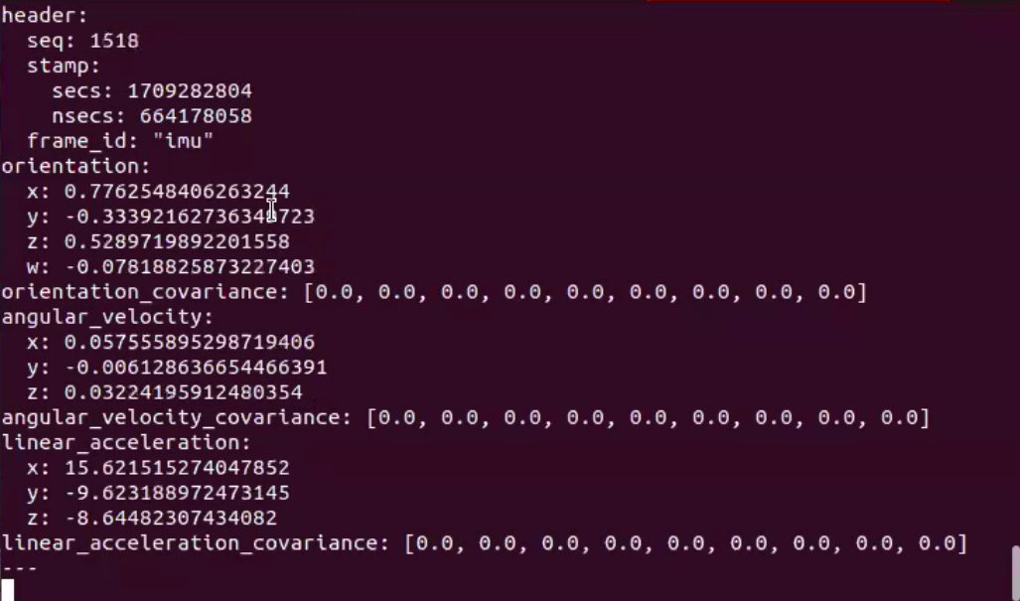
Terminal output
03
IMU
On master device
Rostopic list
Rostopic echo /imu/data_raw
01285960031
01285960031
www.roboticscorner.tech

Slide 26
Encoder
03
Encoder
01285960031
01285960031
www.roboticscorner.tech

Slide 27
Types of encoder
03
Encoder
“Absolute Rotary Encoders” can measure “angular” positions while “Incremental Rotary Encoders” can measure things such as distance, speed, and position.
Rotary Encoders are employed in a wide variety of application areas such as computer input devices like mice and trackballs as well as robotics.
Rotary or Shaft encoders, as previously stated, may be “Absolute” or “Incremental”.
01285960031
01285960031
www.roboticscorner.tech

Slide 28
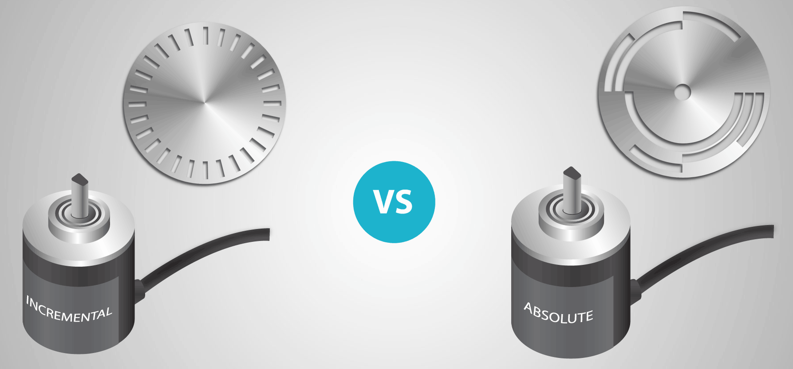
Types of encoder
03
Encoder
01285960031
01285960031
www.roboticscorner.tech

Slide 29
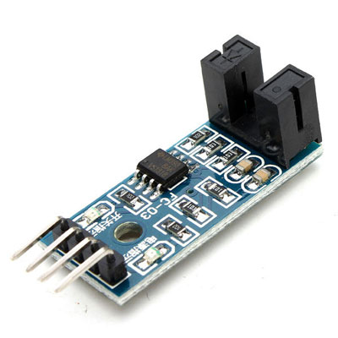
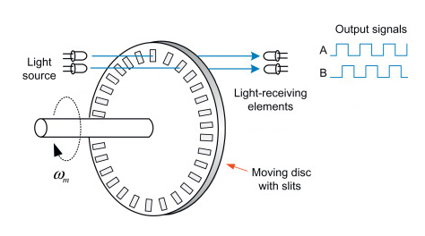
Photoelectric encoder
03
Encoder
We are using an incremental encoder but if you are using encoder with 2 channels to indicate direction that will be better
01285960031
01285960031
www.roboticscorner.tech

Slide 30
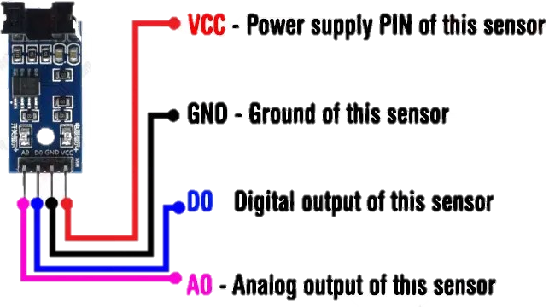
Connections:
03
Encoder
Connecting pins of the speed module (encoder FC-03):
VCC: Module power supply from 3.3V to 12V.
GND: Ground.
D0: Digital signal of the output pulses.
A0: Analog signal of the output pulses. Output signal in real time. (Usually not used).
01285960031
01285960031
www.roboticscorner.tech

Slide 31
Taking data from encoder
03
Encoder
The encoder can be either connected on Arduino and data is sent by serial communication, or connected directly on the raspberry pi
We connect the encoders to the Arduino for testing and better configuration with the motors
After the data is sent to the raspberry pi, another script is written to convert this data to odometry data for ROS to handle
Arduino
Rosserial
Python node
01285960031
01285960031
www.roboticscorner.tech

Slide 32
Arduino code:
03
Encoder
This code must be setup for the Arduino to publish the ticks
Code can be found in this link:
https://automaticaddison.com/how-to-publish-wheel-encoder-tick-data-using-ros-and-arduino/
01285960031
01285960031
www.roboticscorner.tech

Slide 33
Python script
03
Encoder
After getting the data from Arduino, we want to compute odometry from encoder ticks.
This helps in the sensor messages and in the Kalman filter.
You can find the script to convert the tics to odom from here:
https://get-help.theconstruct.ai/t/convert-encoder-data-to-nav-msgs-odometery/24405/4
https://answers.ros.org/question/326434/how-to-compute-odometry-from-encoder-ticks/
01285960031
01285960031
www.roboticscorner.tech

Slide 34
Arduino code:
This code must be setup for the Arduino to publish the ticks
Code can be found in this link:
https://automaticaddison.com/how-to-publish-wheel-encoder-tick-data-using-ros-and-arduino/

Slide 35
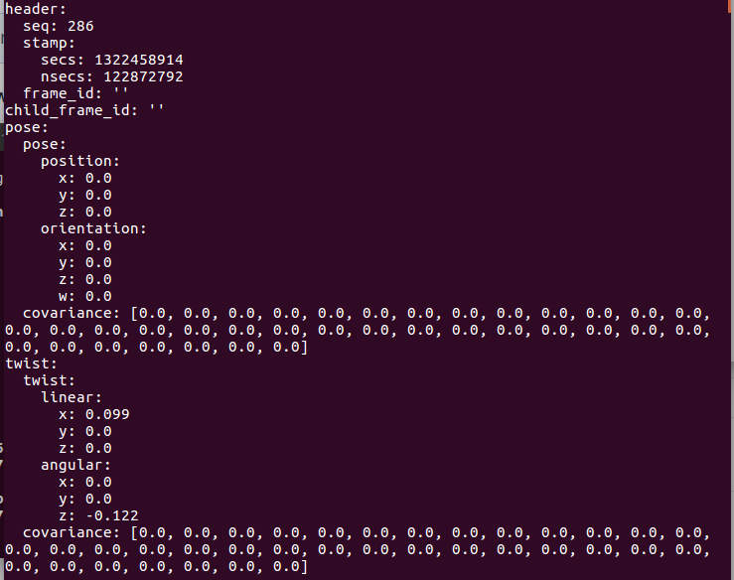
Output on terminal
03
Encoder
This is the format of the odom message
After running the script, the data will start to change
01285960031
01285960031
www.roboticscorner.tech

Slide 36
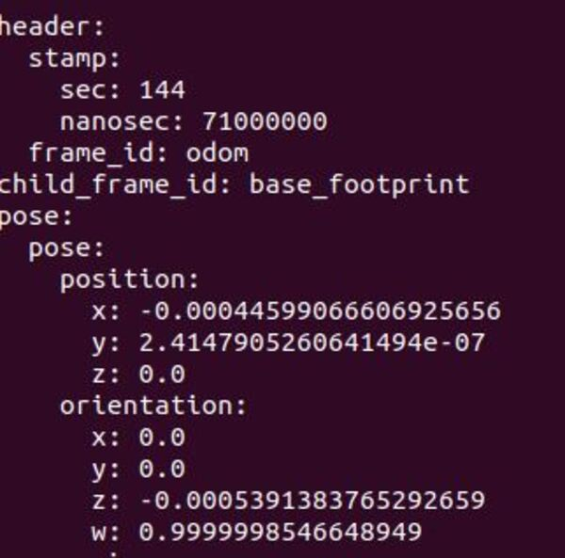
Output on terminal
03
Encoder
After running the script, the data is received and the numbers change
01285960031
01285960031
www.roboticscorner.tech

Slide 37



Slide 38

01211626904
www.roboticscorner.tech
Robotics Corner
Robotics Corner
Robotics Corner
Robotics Corner

